Slide 1
CUSTOMER RELATIONSHIP MANAGEMENT SYSTEM

Slide 2
LIST OF CONTENTS
01
Problem statement
02
Proposed Solution
03
Modules
04
Flow diagram
05
Work done till now
06
Future work
07
Conclusion

Slide 3

CRMS?
Customer Relationship Management System

Slide 4

Welcome!!
What is CRMS?
Customer Relationship Management refers to the study of needs and expectations of a customer and provide them with the right solution.

Slide 5
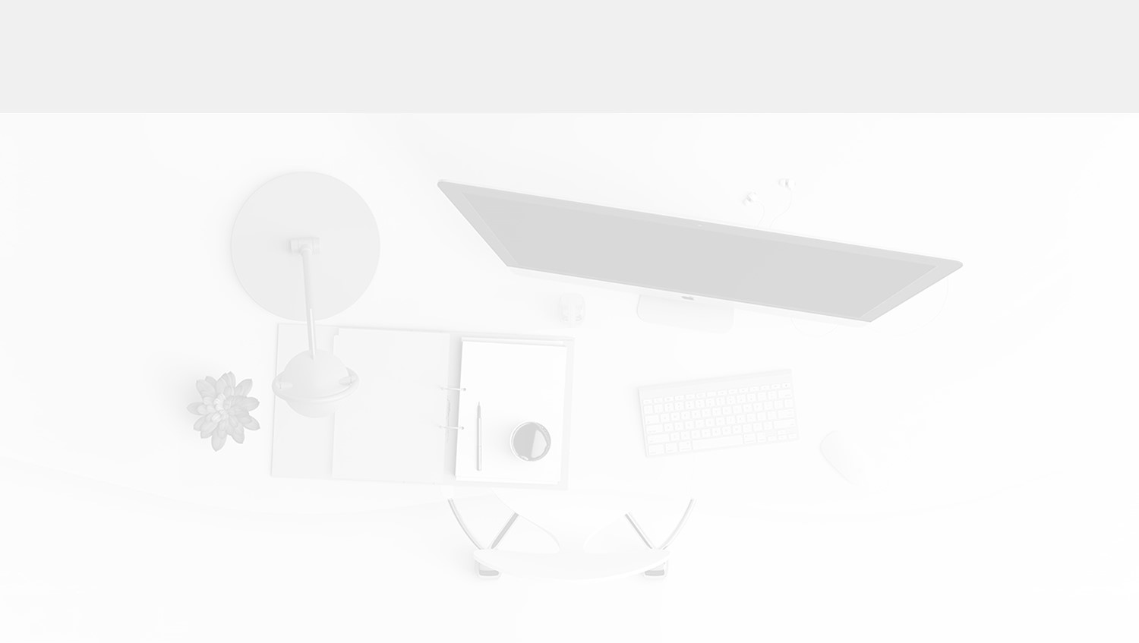
PROBLEM STATEMENT
Problems that are faced by the company as well as customer.
High Manpower needed
01
It is a small scale industry. It has low manpower. Registering a small complain manually it needs a lot of manpower.
Lots of headache
02
Customer as well as Company facing a lot of problems at the time of complain and after sales service. So it is big headache for both.
Lacking of after sales services
The existing system has focused on many things but still not much importance is given to the complain after selling of the product due to which customer relationship is not maintained.
03

Slide 6
PROBLEM STATEMENT
Problems that are faced by the company as well as customer.
Service center management
04
Customer faces a lot of problems while finding a nearby service center. As it becomes a huge task for him/her to find and service their product.
Difficult as well as time consuming
05
Right from purchase to complain or any further details the customer has to constantly visit the company or to be in contact with the company members.
Everything is done manually
06
Product registration, purchasing, complain, after sales services etc. Everything is entered manually which requires time as well as manpower.

Slide 7
Proposed Solutions
We hereby provide some of the solutions of all the mentioned problems.
Easiness and requires low manpower
Everything will be online so it becomes easy for customer to view and check anything at anytime. On the other hand company needs least amount of staff.
Simple and Easy to use
We would be making our system user friendly, very easy graphics are provided due to which it becomes handy and easy to operate.
Proper complain management
We will be providing all the details regarding the product and service centers. So complain would be easily registered after logging into the system.

Slide 8
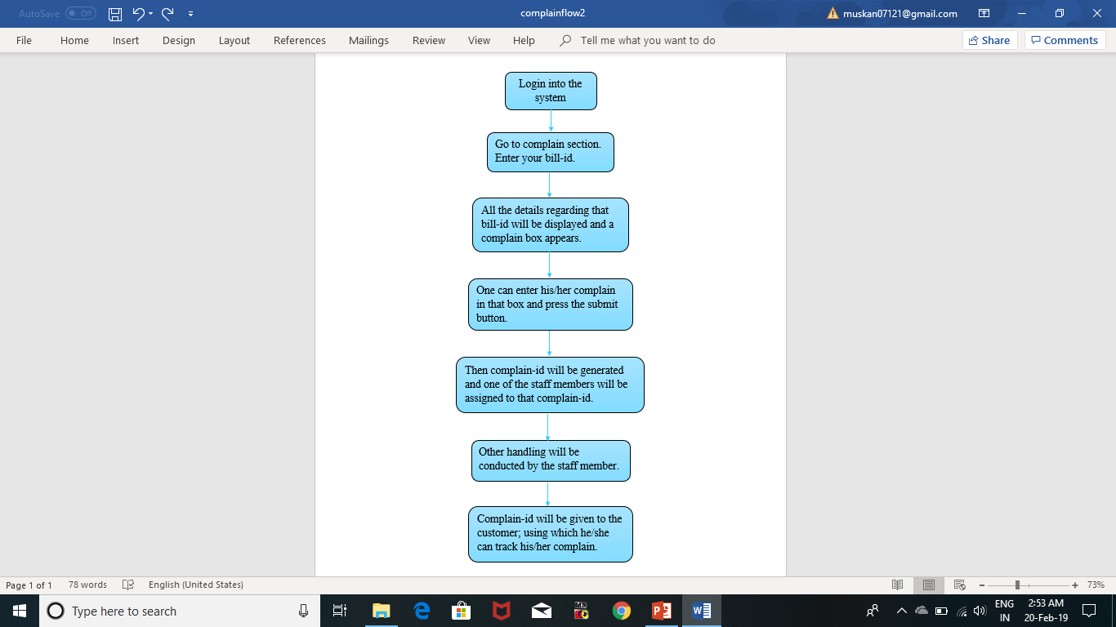
FLOW OF COMPLAIN
Complain will be registered by the customer.
Complain will be generated from bill-id and then
complain-id will be created.
This generated complain-id will be assigned to one of the staff members to continue the
further required processes.
And customer will be provided with their respective complain-id and they can track their complain by
using it.

Slide 9
MODULES
A module is a software component or part of a program that contains one or more routines.
CUSTOMER
ADMIN
STAFF
CUSTOMER
ADMIN
STAFF
A customer is an individual that purchase the goods or services produced by a company.
The administration of a business, organization, etc.
All the people employed by a particular organization.

Slide 10
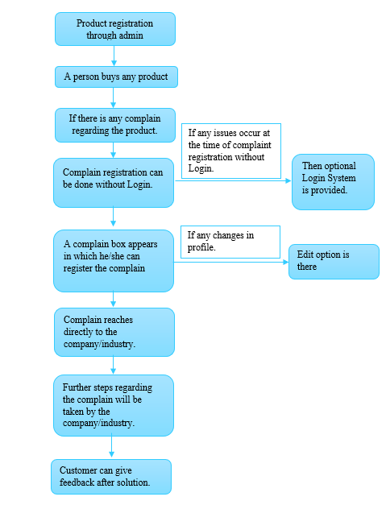
FLOW
DIAGRAM

Slide 11
WORK DONE TILL NOW
A
C
D
B
E
A
Problem statement and Language has be selected.
B
The challenges have been shot-listed which are being facing in the current system.
C
Some of the solutions have been found and some from them some have been even implemented.
D
Work has been distributed individually and everyone started to indulged in it accordingly.
E
Planning, plotting, report, etc. are being discussed

Slide 12
IN OUR MIND
Future ideas that we are going to implement.!!
Security will be maintained.
The details regarding all the products he/she bought will be displayed.
We’ll try our level best to maintain the relationship between the customer and company.
Customer will be able to track his/her complain.
All the service center details will be displayed.

Slide 13

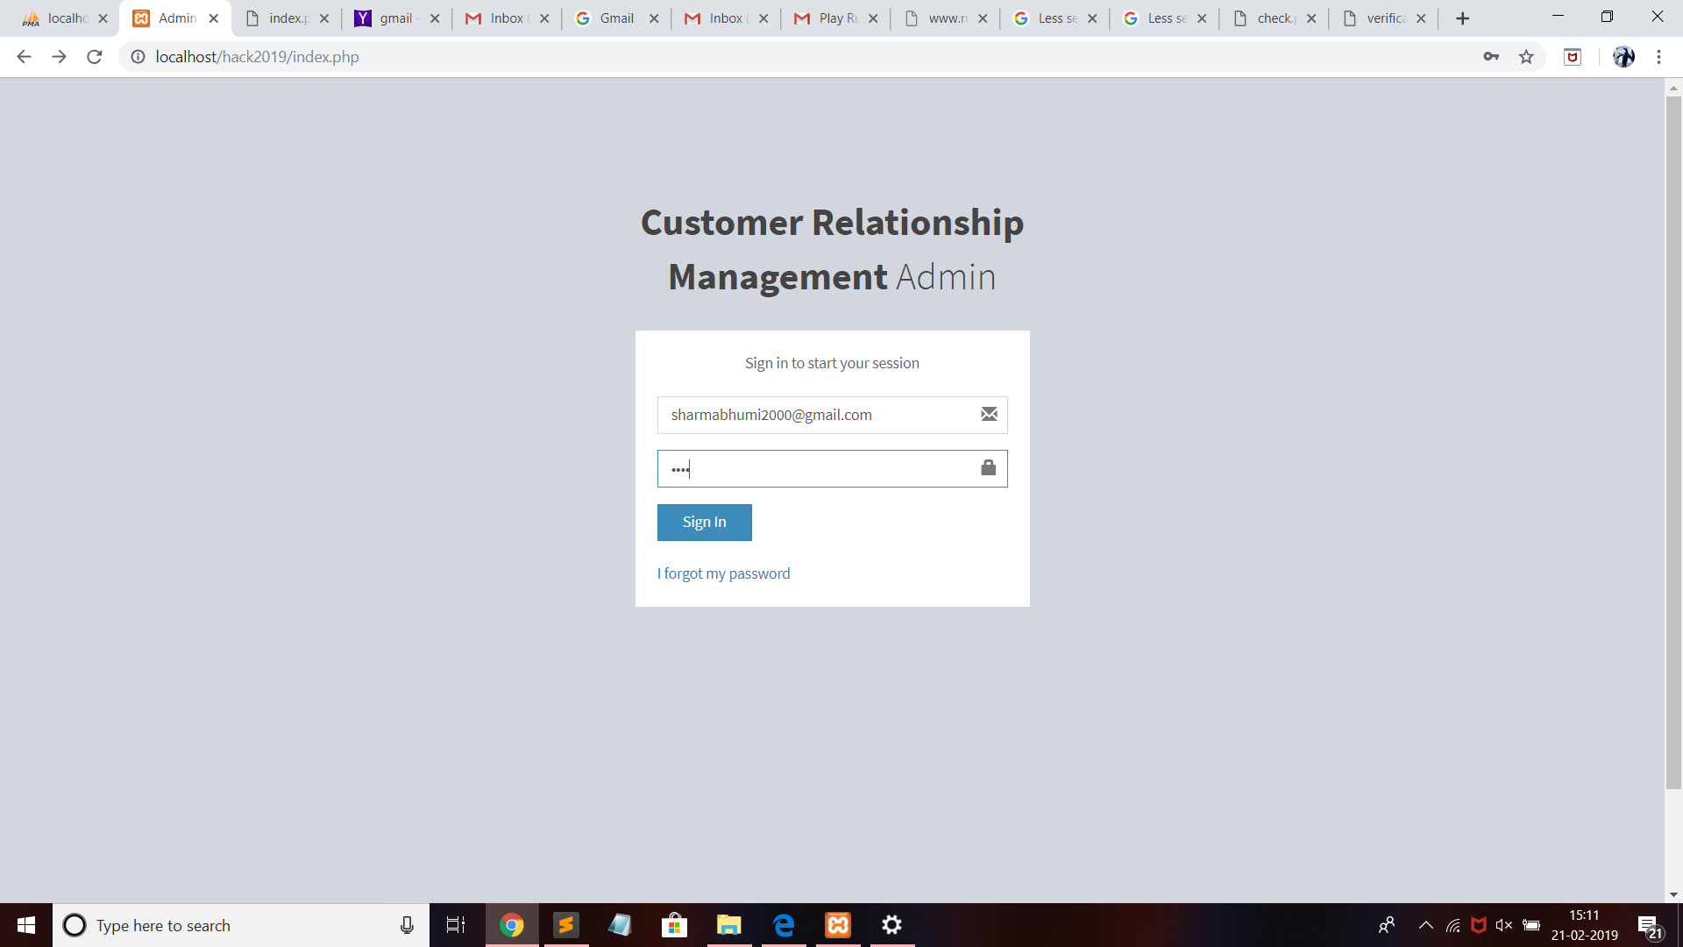
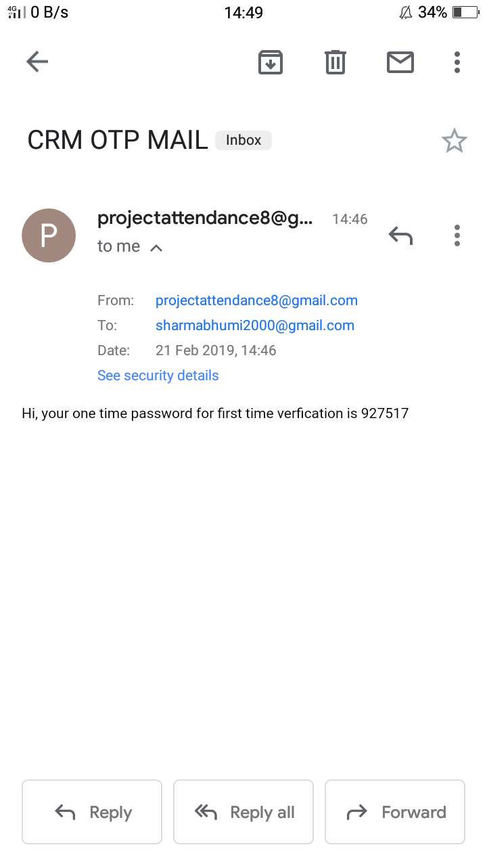
IMPLEMENTATION TILL NOW
Login page with system generated OTP(One time password) in G-mail:

Slide 14
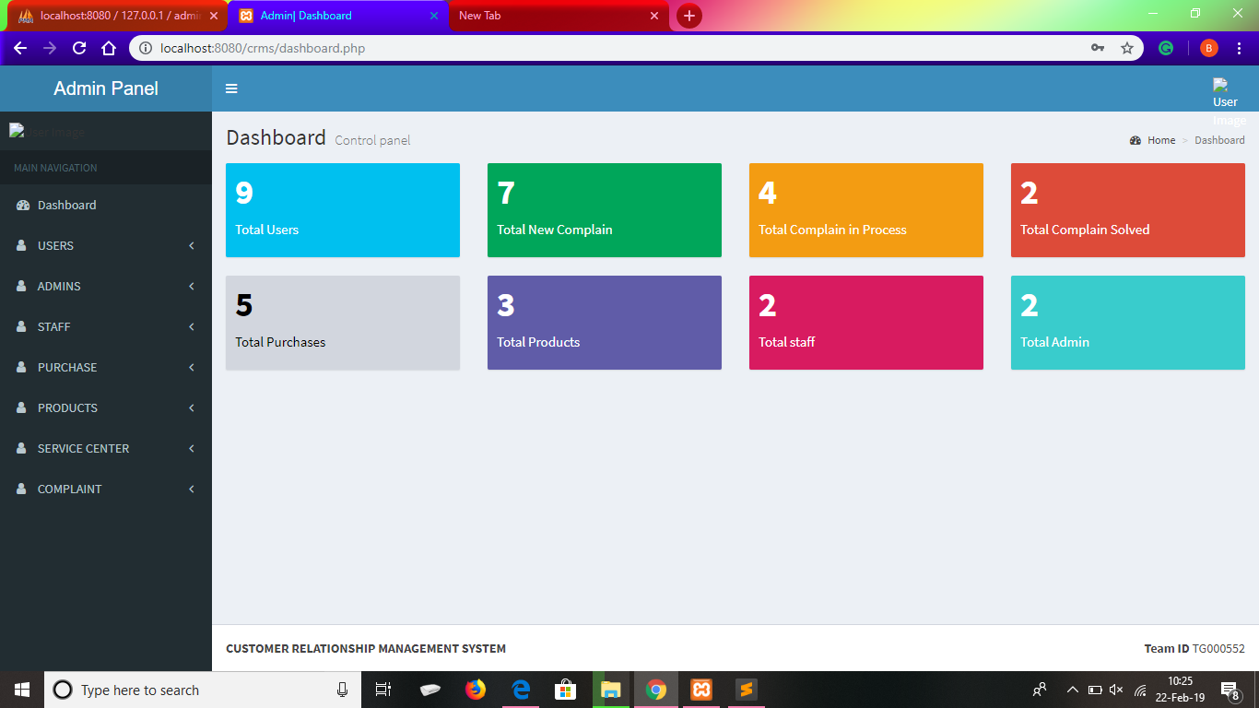
Admin Panel Dashboard
:

Slide 15
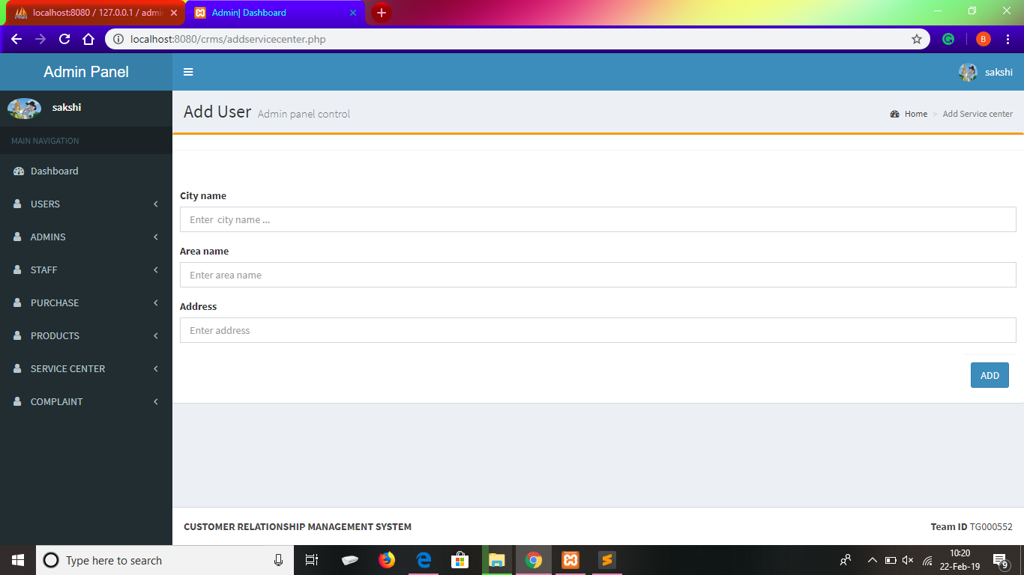
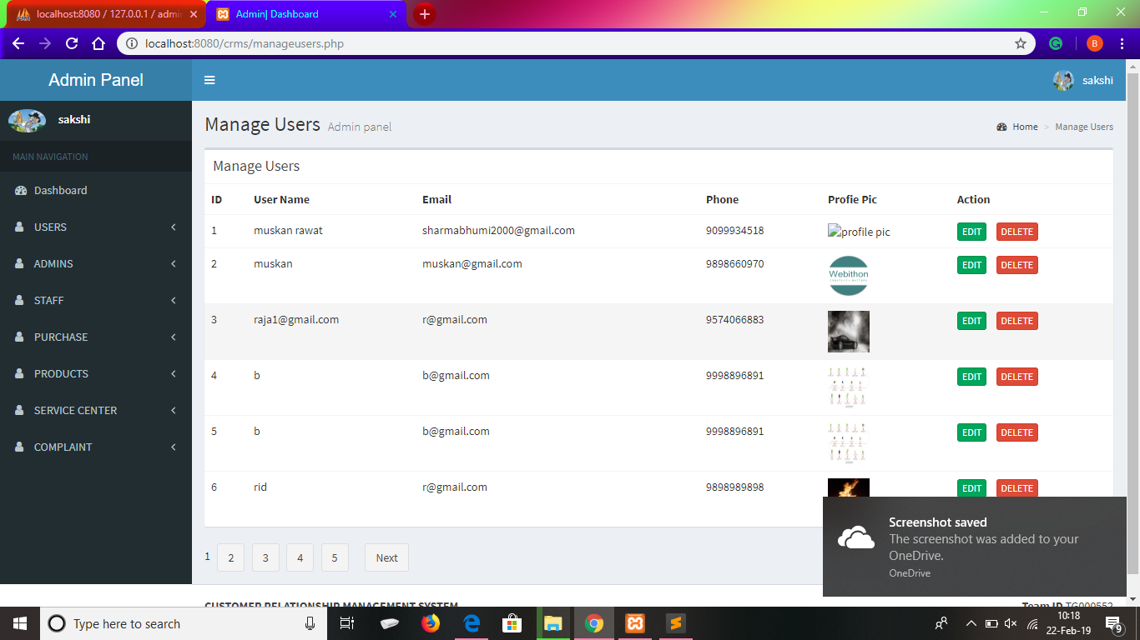
Admin can add user and manage user

Slide 16
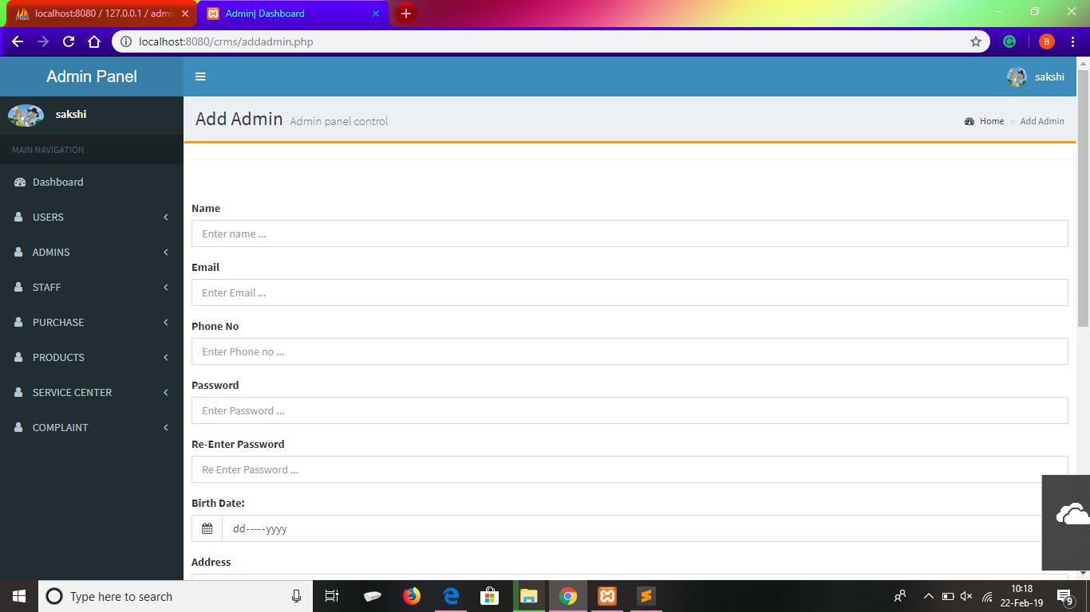
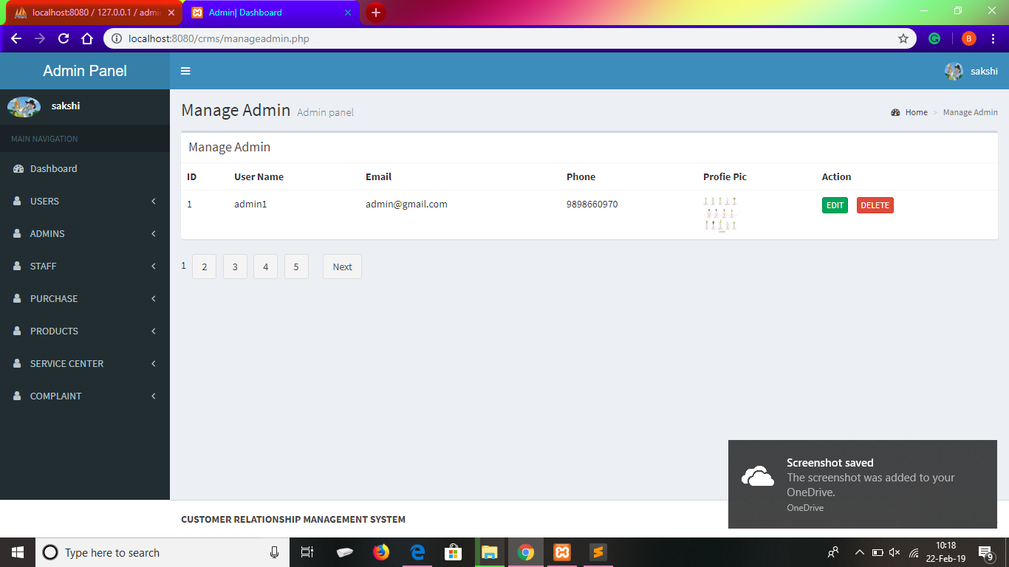
Admin can add admin and manage admin

Slide 17
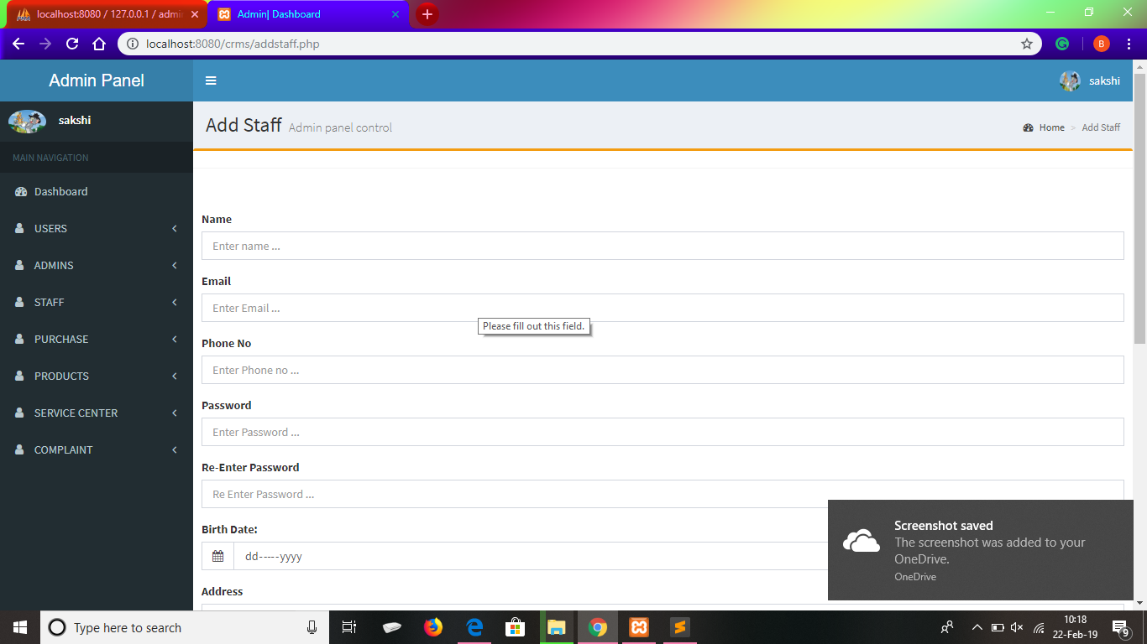
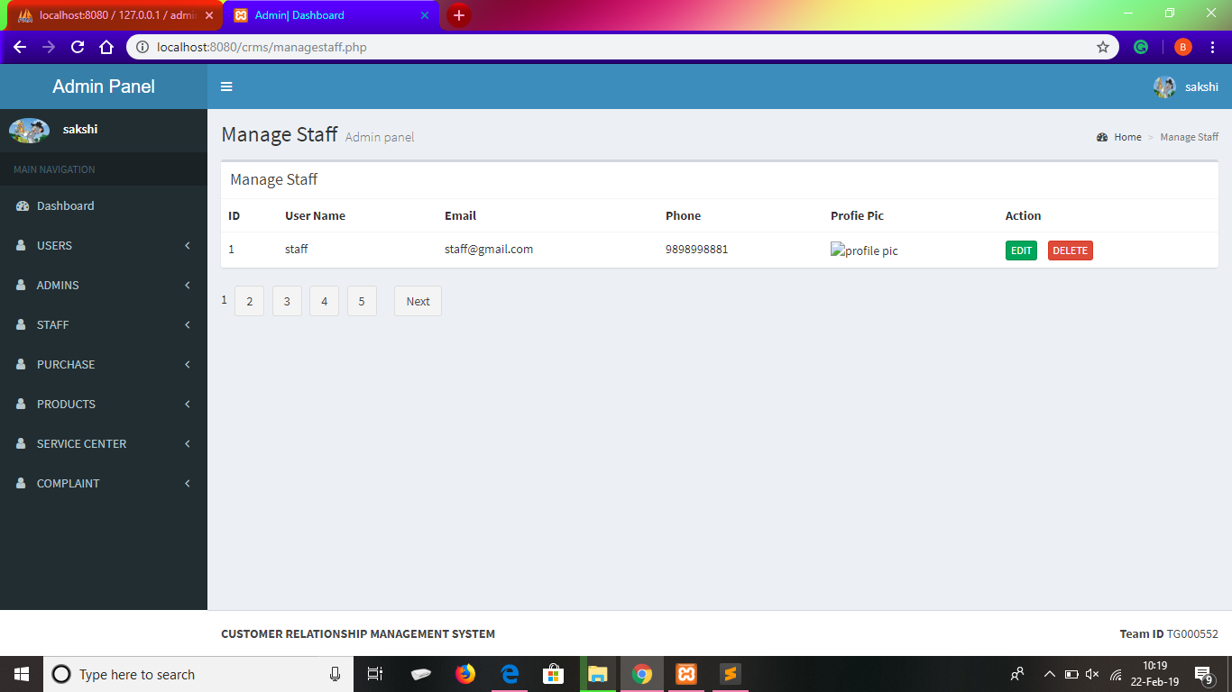
Admin can add staff and manage staff

Slide 18
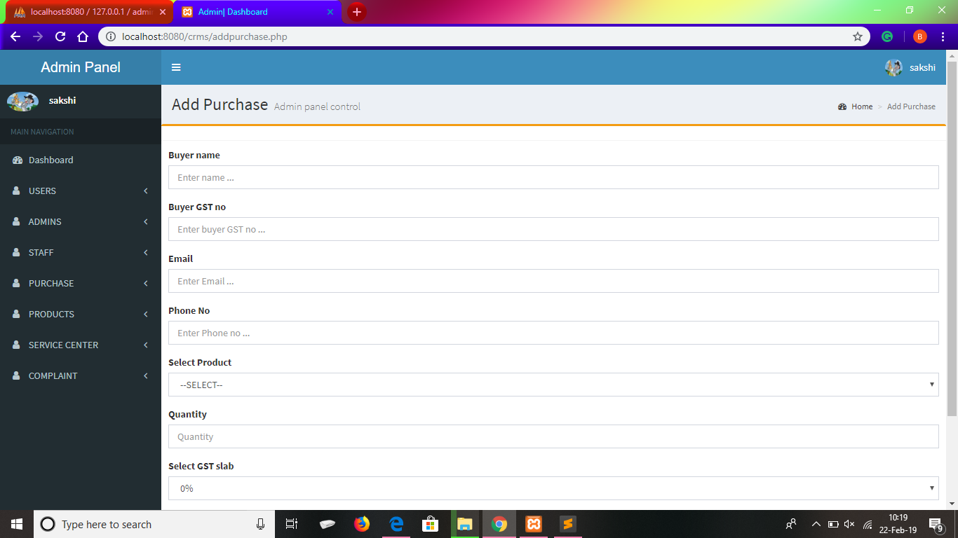
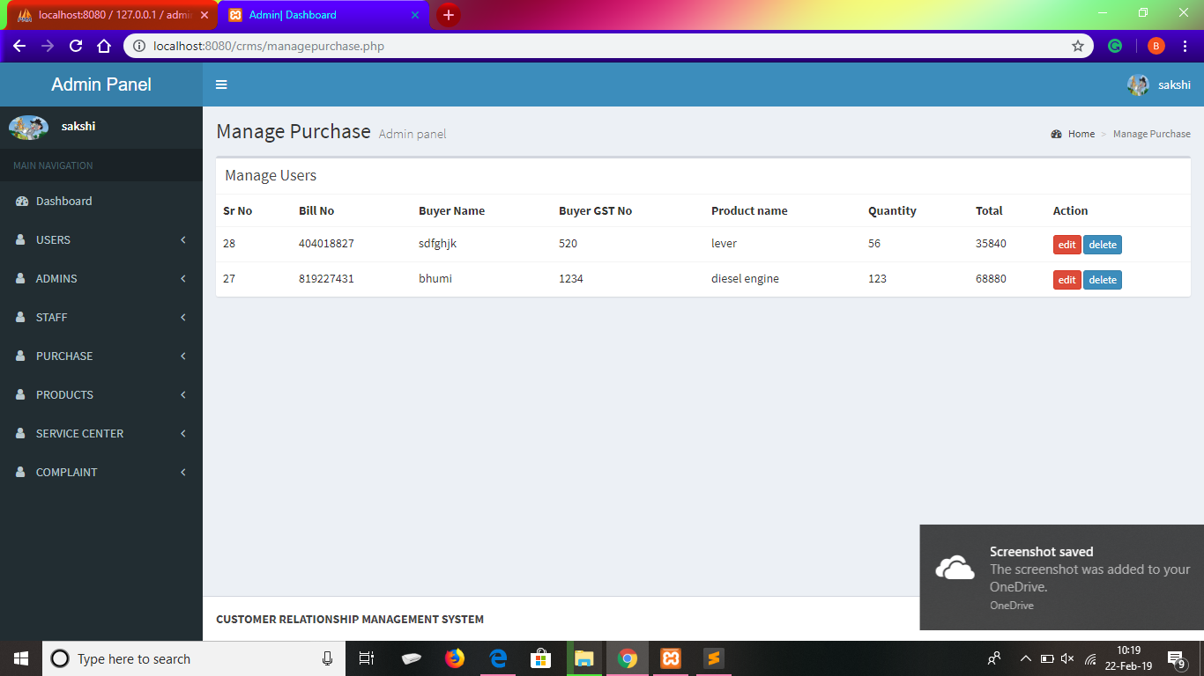
Admin can add purchase and manage purchase

Slide 19
Admin can add product and manage product

Slide 20
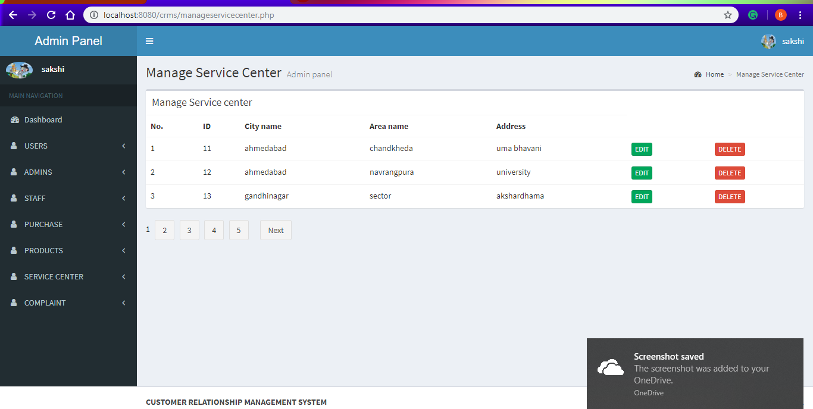
Admin can manage service centre

Slide 21
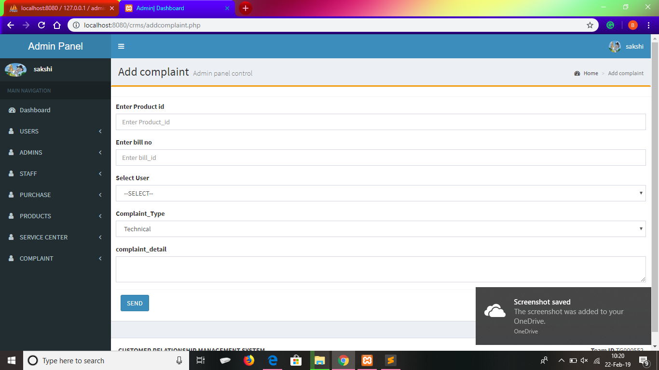
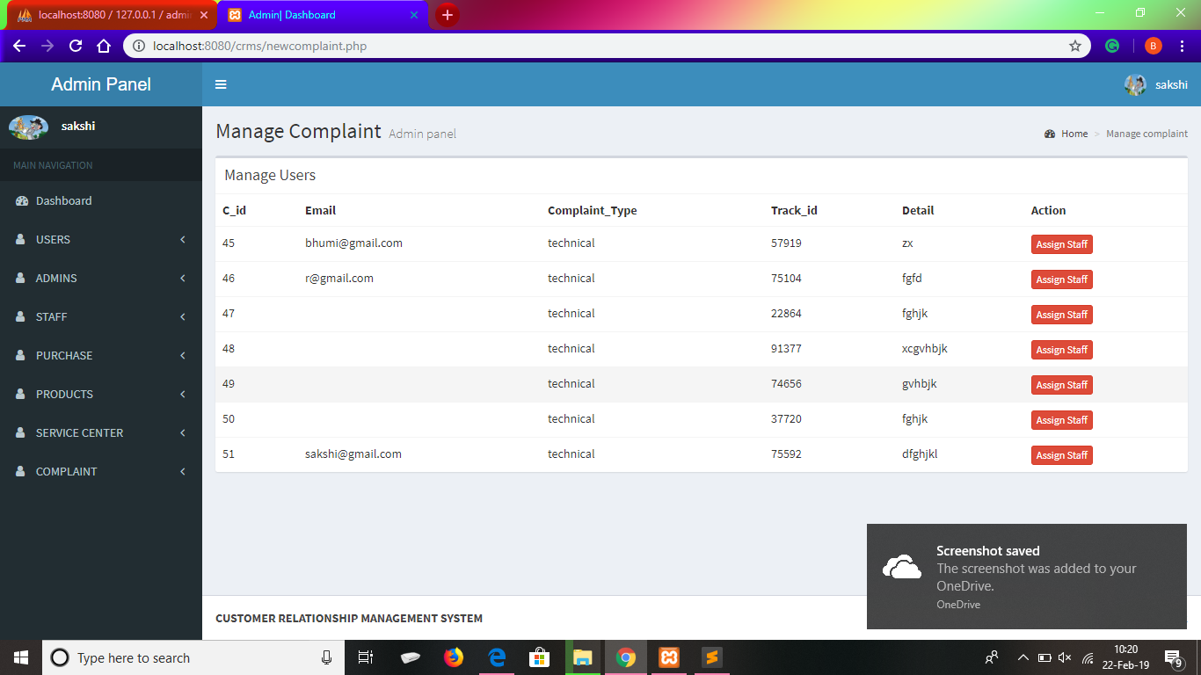
Admin can add complain and manage complain

Slide 22
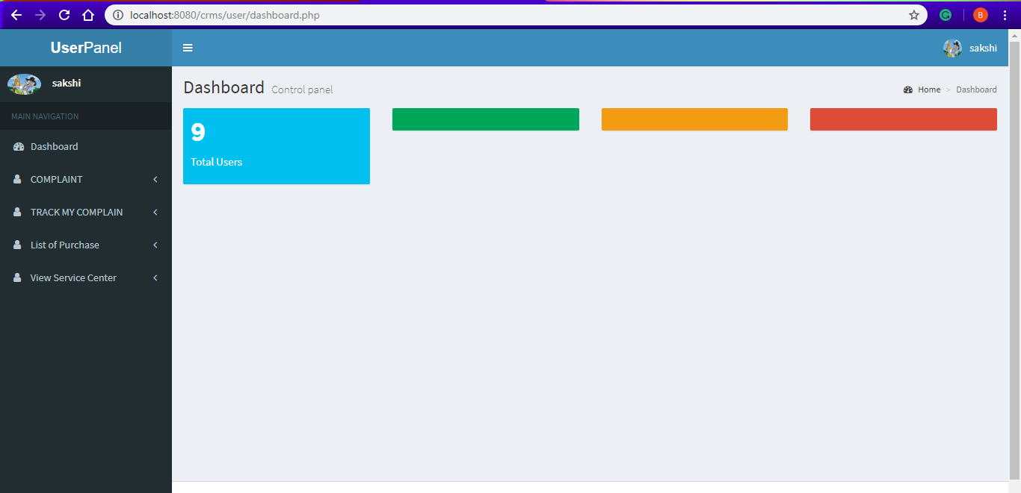
User Panel Dashboard

Slide 23
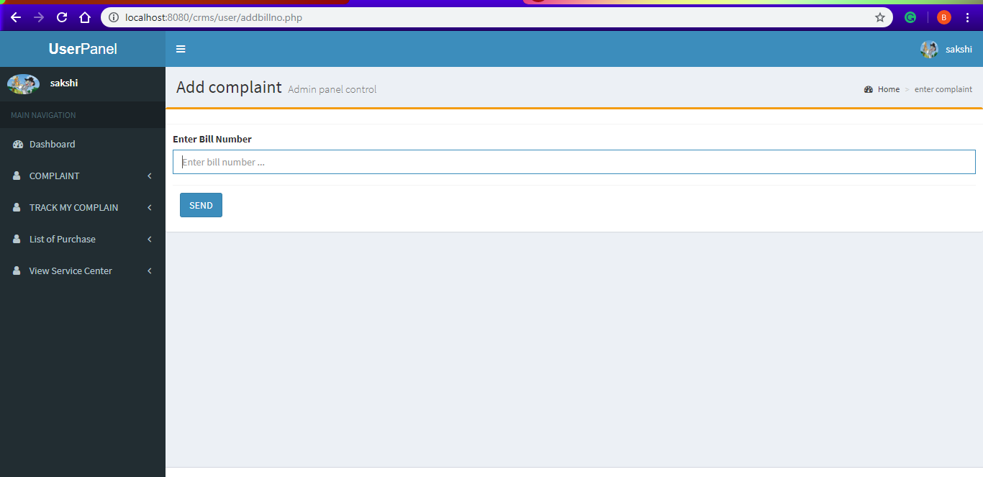
User can add complain

Slide 24
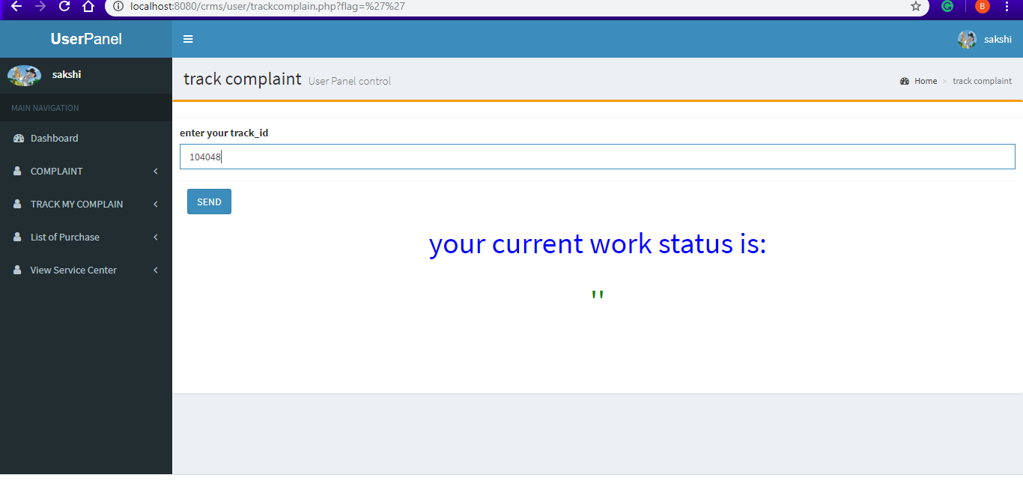
User can track complain

Slide 25

User can view list of all purchased products and can also make complain

Slide 26
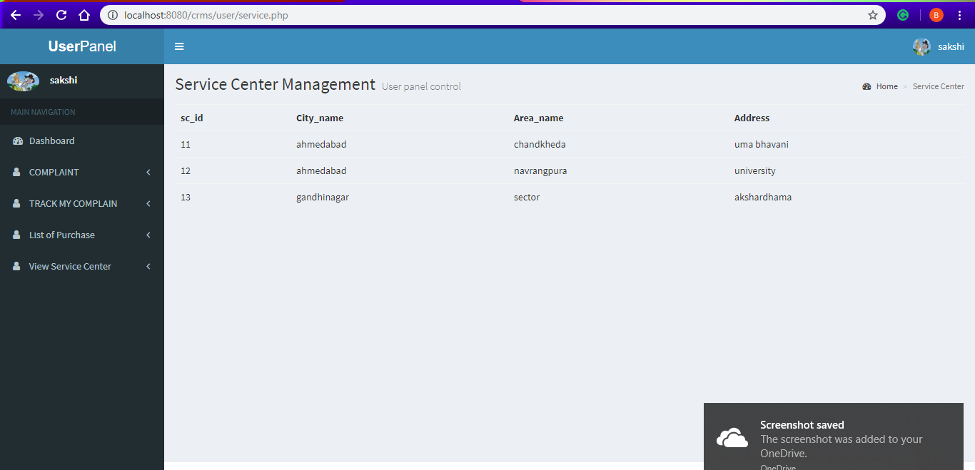
User can view service centre

Slide 27
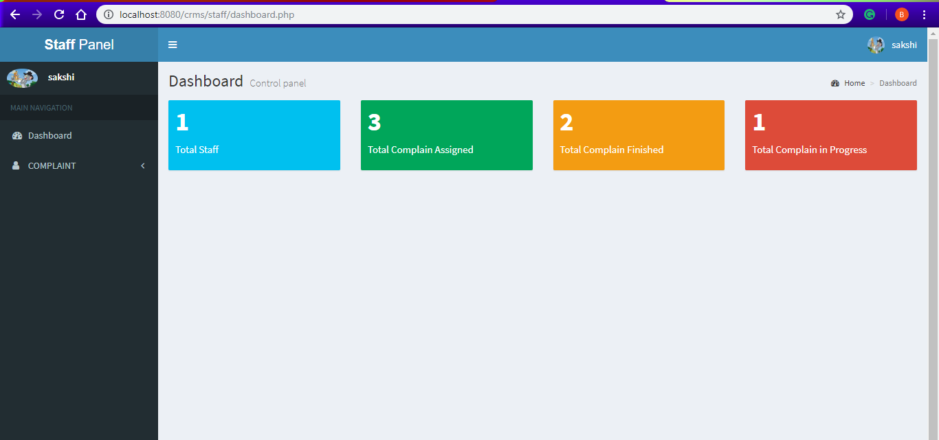
Staff Panel Dashboard

Slide 28
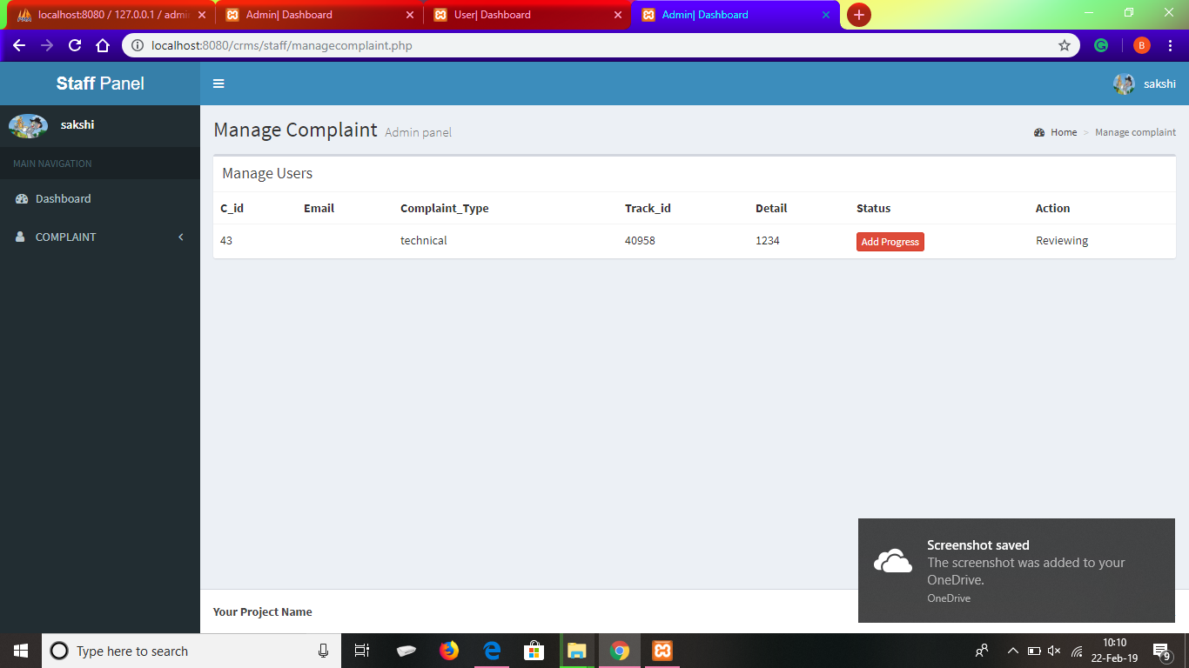
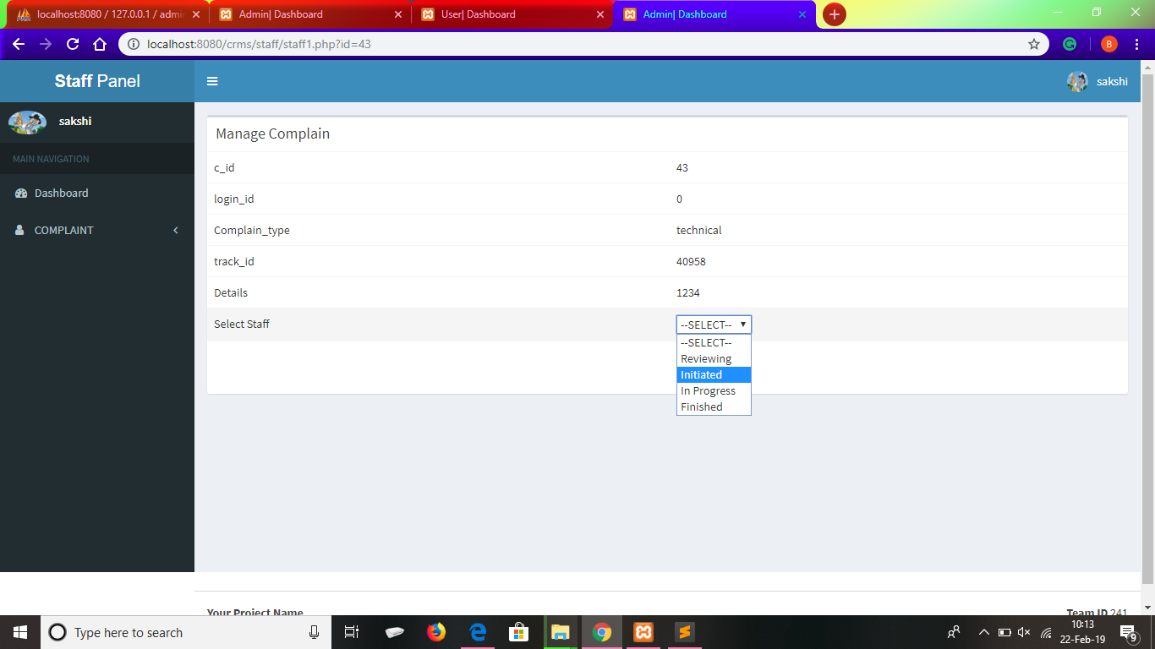
Staff can Manage complains

Slide 29
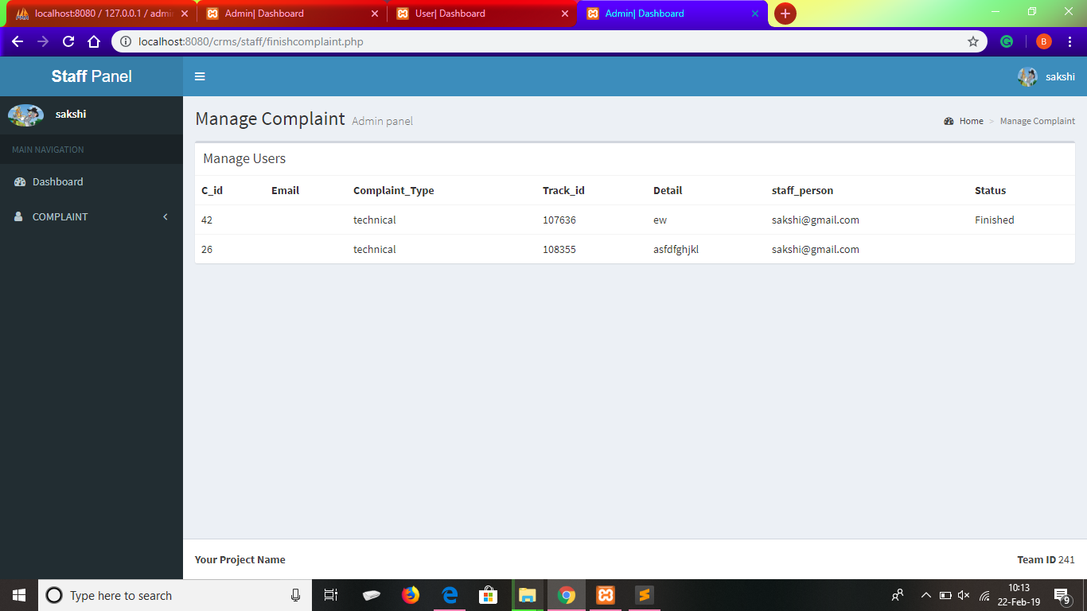
Staff can view his/her all finished complains

Slide 30
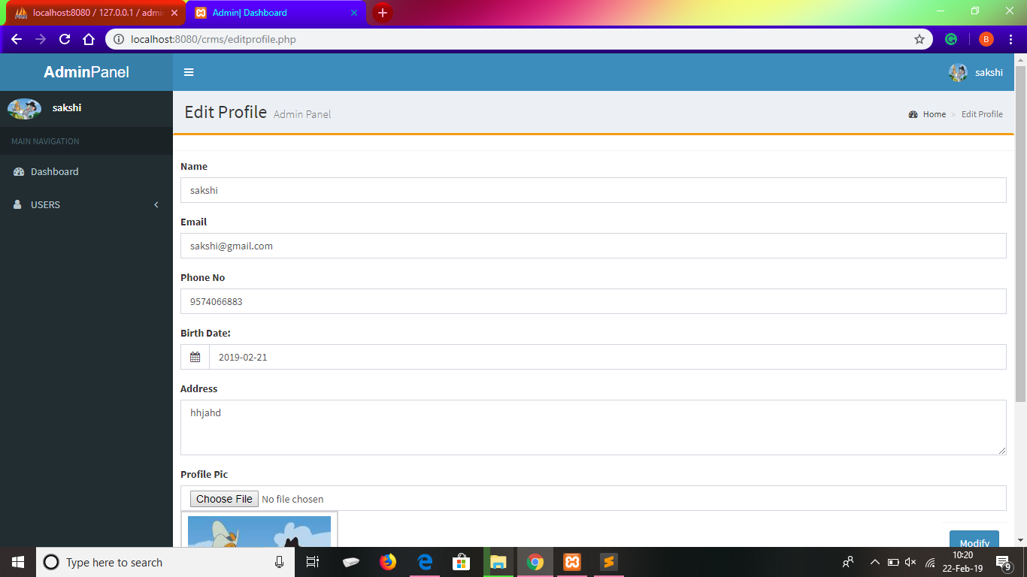
Edit profile

Slide 31
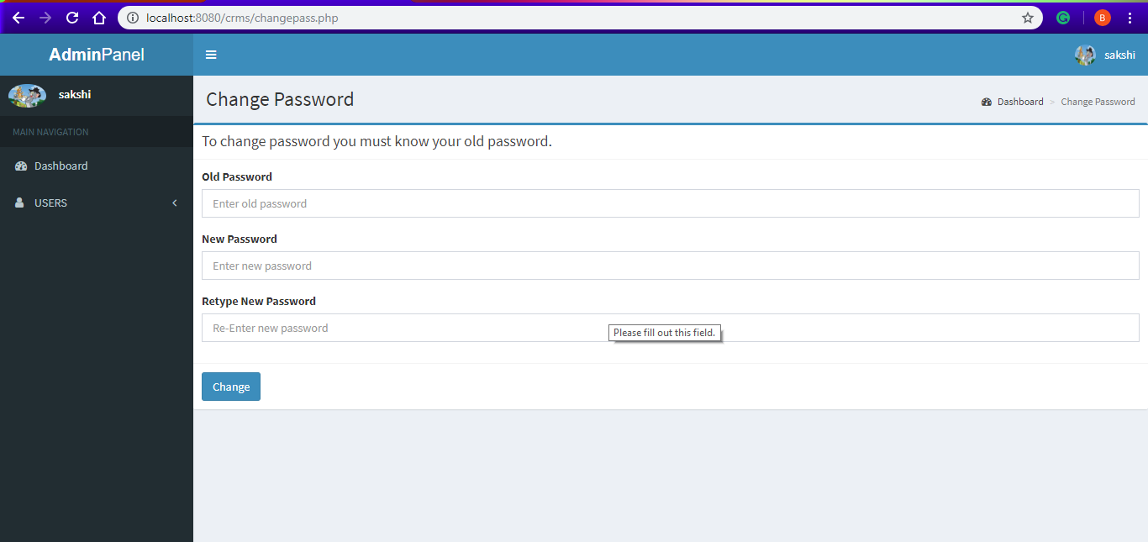
Change password

Slide 32
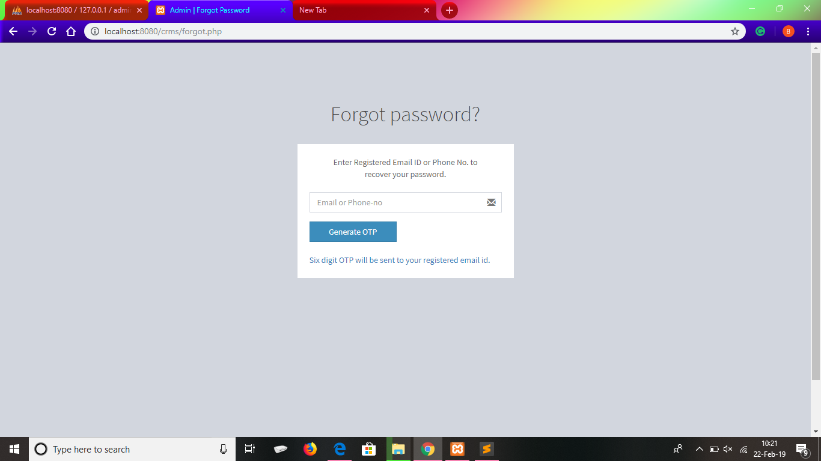
Forgot password

Slide 33
Thank you
For having us

